Slide 1
General Introduction for Interested Schools

Slide 2
CLASSESS
Track social-emotional behaviors
Generate visual displays of student performance
Measure intervention effectiveness
Keep parents informed

Slide 3
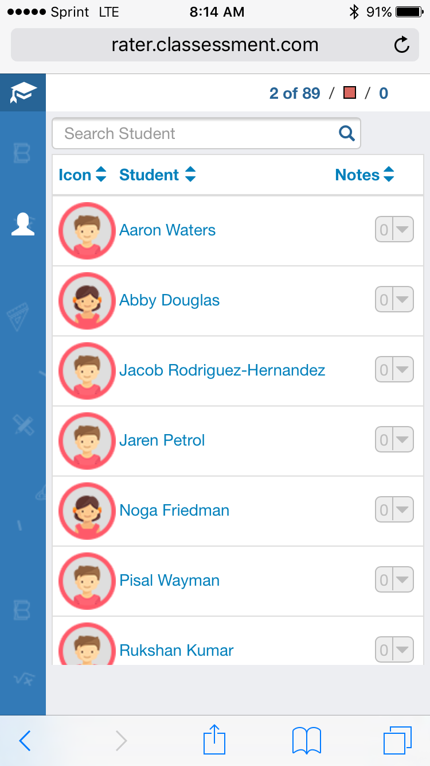
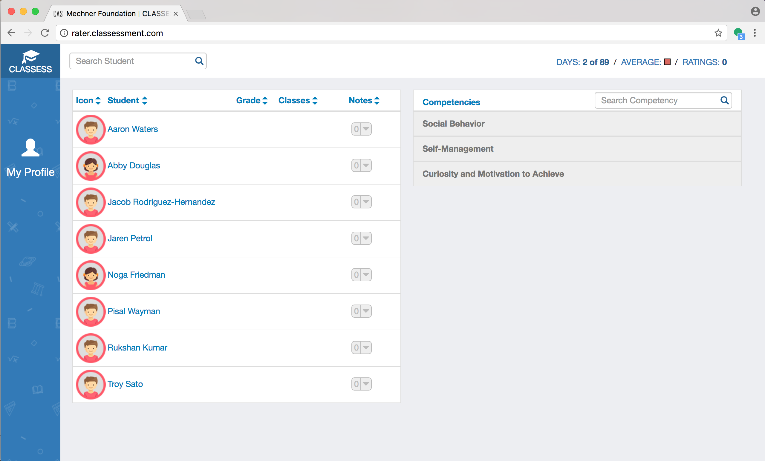
Online, friendly access

Slide 4
Intuitive Recording System
Observe students’ non-academic behaviors
When your schedule allows, select the student and record their behaviors under the right competencies
Indicate where it occurred
Record their performance as positive, neutral or negative
Add comments

Slide 5
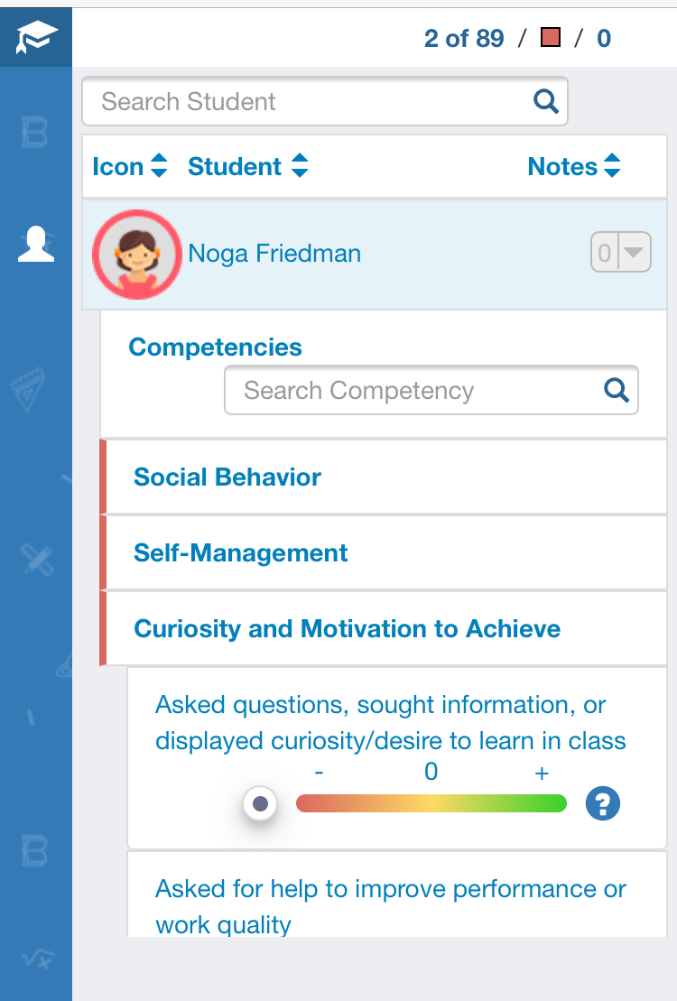
Quickly Track Observable Behaviors
Social-emotional learning made tangible with observable competencies
Spend as little as 5 minutes a day recording behavior

Slide 6
Generate Reports & Review Data
Compare performance across time
Visual report options:
Individual Student
Individual Teacher
Classroom
Grade Level
School
Parent

Slide 7
Align & Intervene
CLASSESS is compatible with other school-wide interventions and evidence-based practices
Align CLASSESS’ powerful data system with programs such as PBIS, RtI, Good Behavior Game, ACEs interventions, and trauma-informed care

Slide 8
Staff Motivation & Communication
A leaderboard creates accountability among staff.
A messaging function keeps teachers and teams in sync.
Staff can earn badges for their CLASSESS accomplishments.

Slide 9
Reminder & Summary Emails
Stay on track with daily reminders to record and review your students’ performance
Receive usage feedback for you and your peers

Slide 10
Personalize CLASSESS
Meet your district and school’s SEL goals by customizing the CLASSESS competencies and your interventions
Let teachers and students guide how you track and intervene

Slide 11
Training & Support
Implementation begins with staff training on CLASSESS mechanics, observing social-emotional behavior, and analyzing data
Schools build in-house coaching and feedback systems to support all team members

Slide 12
School-wide Data Analysis
Don’t leave social-emotional learning to chance! Instead, constantly monitor the progress of your school and district
Use your school’s data to guide allocation of resources, and support teachers and students

Slide 13
Questions?
Feel free to contact us!
ash@mechnerfoundation.org
1.540.335.5049

